Slide 1
Operating System Fundamentals
Computer Engineering
Notes:
Introduction to the presentation on Operating System Fundamentals.

Slide 2

Introduction to Operating Systems
Operating systems manage computer hardware and software resources efficiently and effectively always
OS provides a platform for running applications and services seamlessly and securely always
Key components of operating systems include process management and memory management functions
Operating systems control input output operations and device management tasks always
Security and authentication mechanisms are crucial components of modern operating systems
File systems and storage management are essential features of operating systems always
Operating systems provide a user interface for interacting with computer systems easily
Multitasking and multithreading capabilities are supported by most modern operating systems
Operating systems support networking and communication protocols for data exchange always
Error handling and debugging mechanisms are important aspects of operating system design
Notes:
Present Introduction to Operating Systems in the context of Operating System Fundamentals.

Slide 3
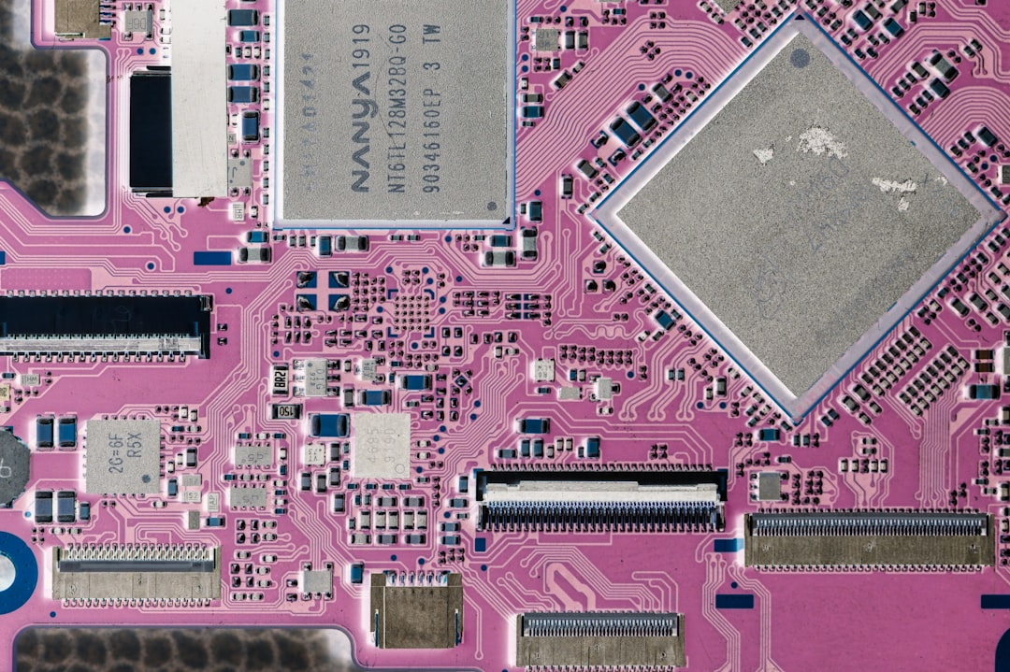
Process Management Concepts
A process is a program in execution with its own memory space.
Process scheduling determines which process runs at a given time.
Notes:
Present Process Management Concepts in the context of Operating System Fundamentals.

Slide 4
Memory Management Techniques
Paging technique divides memory into fixed-size blocks for efficient allocation
Segmentation method divides memory into variable-size blocks for organization
Virtual memory combines physical and secondary storage for increased capacity
Swapping technique involves exchanging pages between main and secondary memory
Memory fragmentation occurs when free memory is broken into small blocks
Heap management involves allocating and deallocating memory for dynamic data
Stack management involves allocating and deallocating memory for function calls
Cache memory stores frequently accessed data for rapid retrieval
Memory protection mechanisms prevent unauthorized access to memory regions
Notes:
Present Memory Management Techniques in the context of Operating System Fundamentals.

